Slide 1
MMR proteins:
How and why should they be detected in 2024?
Jean-Christophe B Sabourin
Rouen University Hospital Normandy FRANCE

Slide 2
Disclosure of Relevant Financial Relationships
Dr. JC B Sabourin declares he has
conflicts of interest to disclose
Participation in scientific boards or symposiums for: Amgen, Astellas, AstraZeneca, BMS, Incyte, MSD, Pierre Fabre, Servier
within the past 12 months, which relates to the content of this educational activity and could create a conflict of interest
RDC Nº 96/08 da ANVISA

Slide 3


A case report for introduction
MMR proteins: How and why should they be detected in 2024?

Slide 4
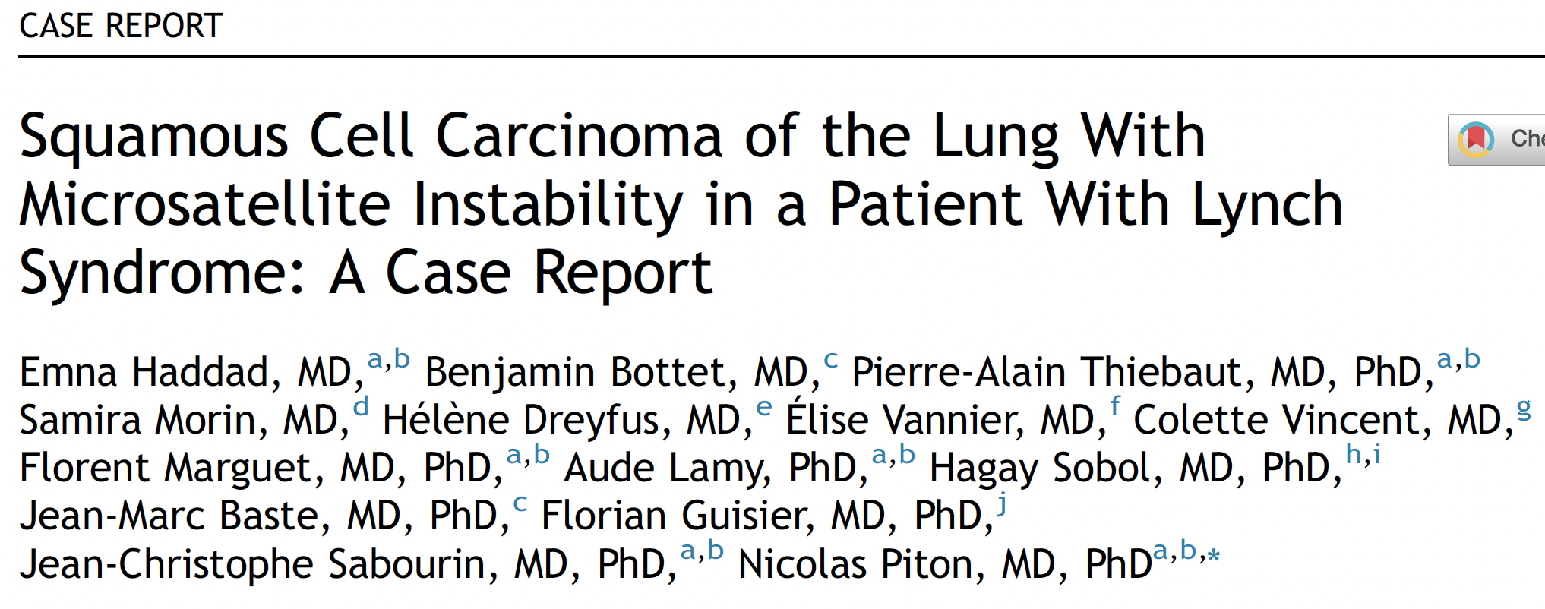
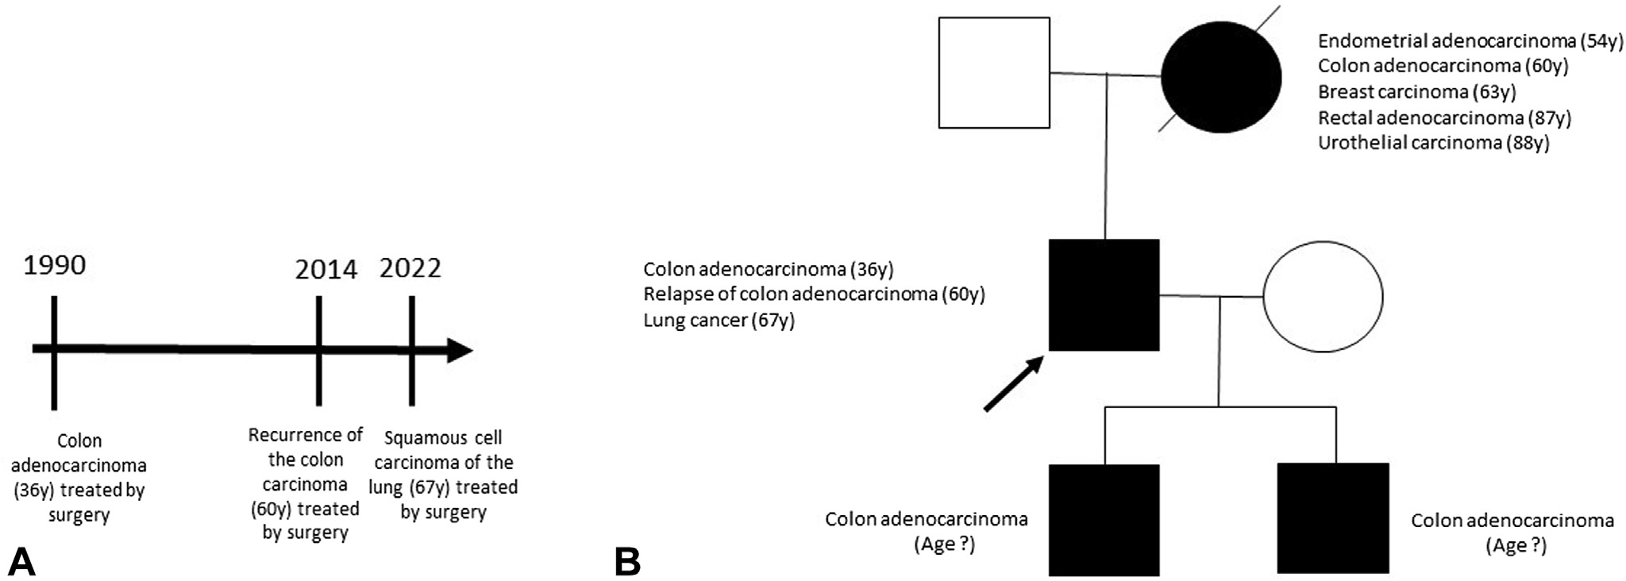
Germline mutation in
MLH1(c.1943C>T, p.Pro648Leu)
Lynch Syndrome
In 2022, a 68-year-old white man with a 25-pack-year smoking history (cessation since 2014) presented fatigue and cough
In 1990 (at the age of 36 y) the patient presented an adenocarcinoma of the right colon treated with surgery, recurring in 2014
In addition to the occurrence of cancer at a young age, his family medical history was suggestive of an inherited cancer-predisposing syndrome, with cancers occurring in his mother and his two sons
JTO Clinical and Research Reports 2023
https://doi.org/10.1016/j.jtocrr.2023.100595

Slide 5
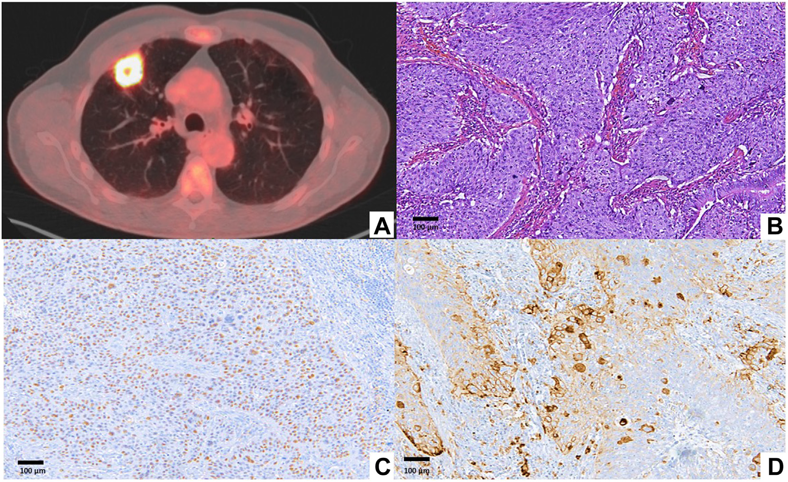
In August 2022, as part of the follow-up of his colon cancer, a computed tomography scan was performed, which revealed a nodule on the right upper lobe measuring 32 mm
A transparietal needle biopsy
of this lesion was performed, which revealed squamous cell carcinoma
In December 2022, the patient had a roboticassisted thoracic surgery of the right upper lobe with radical lymph node dissection
Pathologic examination confirmed the
diagnosis of squamous cell carcinoma, with the expression of p40 in tumor cells and a TPS PD-L1 at 40%
P40
PD-L1
Tumor cells did not express GATA3,
excluding a lung metastasis of urothelial carcinoma
JTO Clinical and Research Reports 2023
https://doi.org/10.1016/j.jtocrr.2023.100595

Slide 6
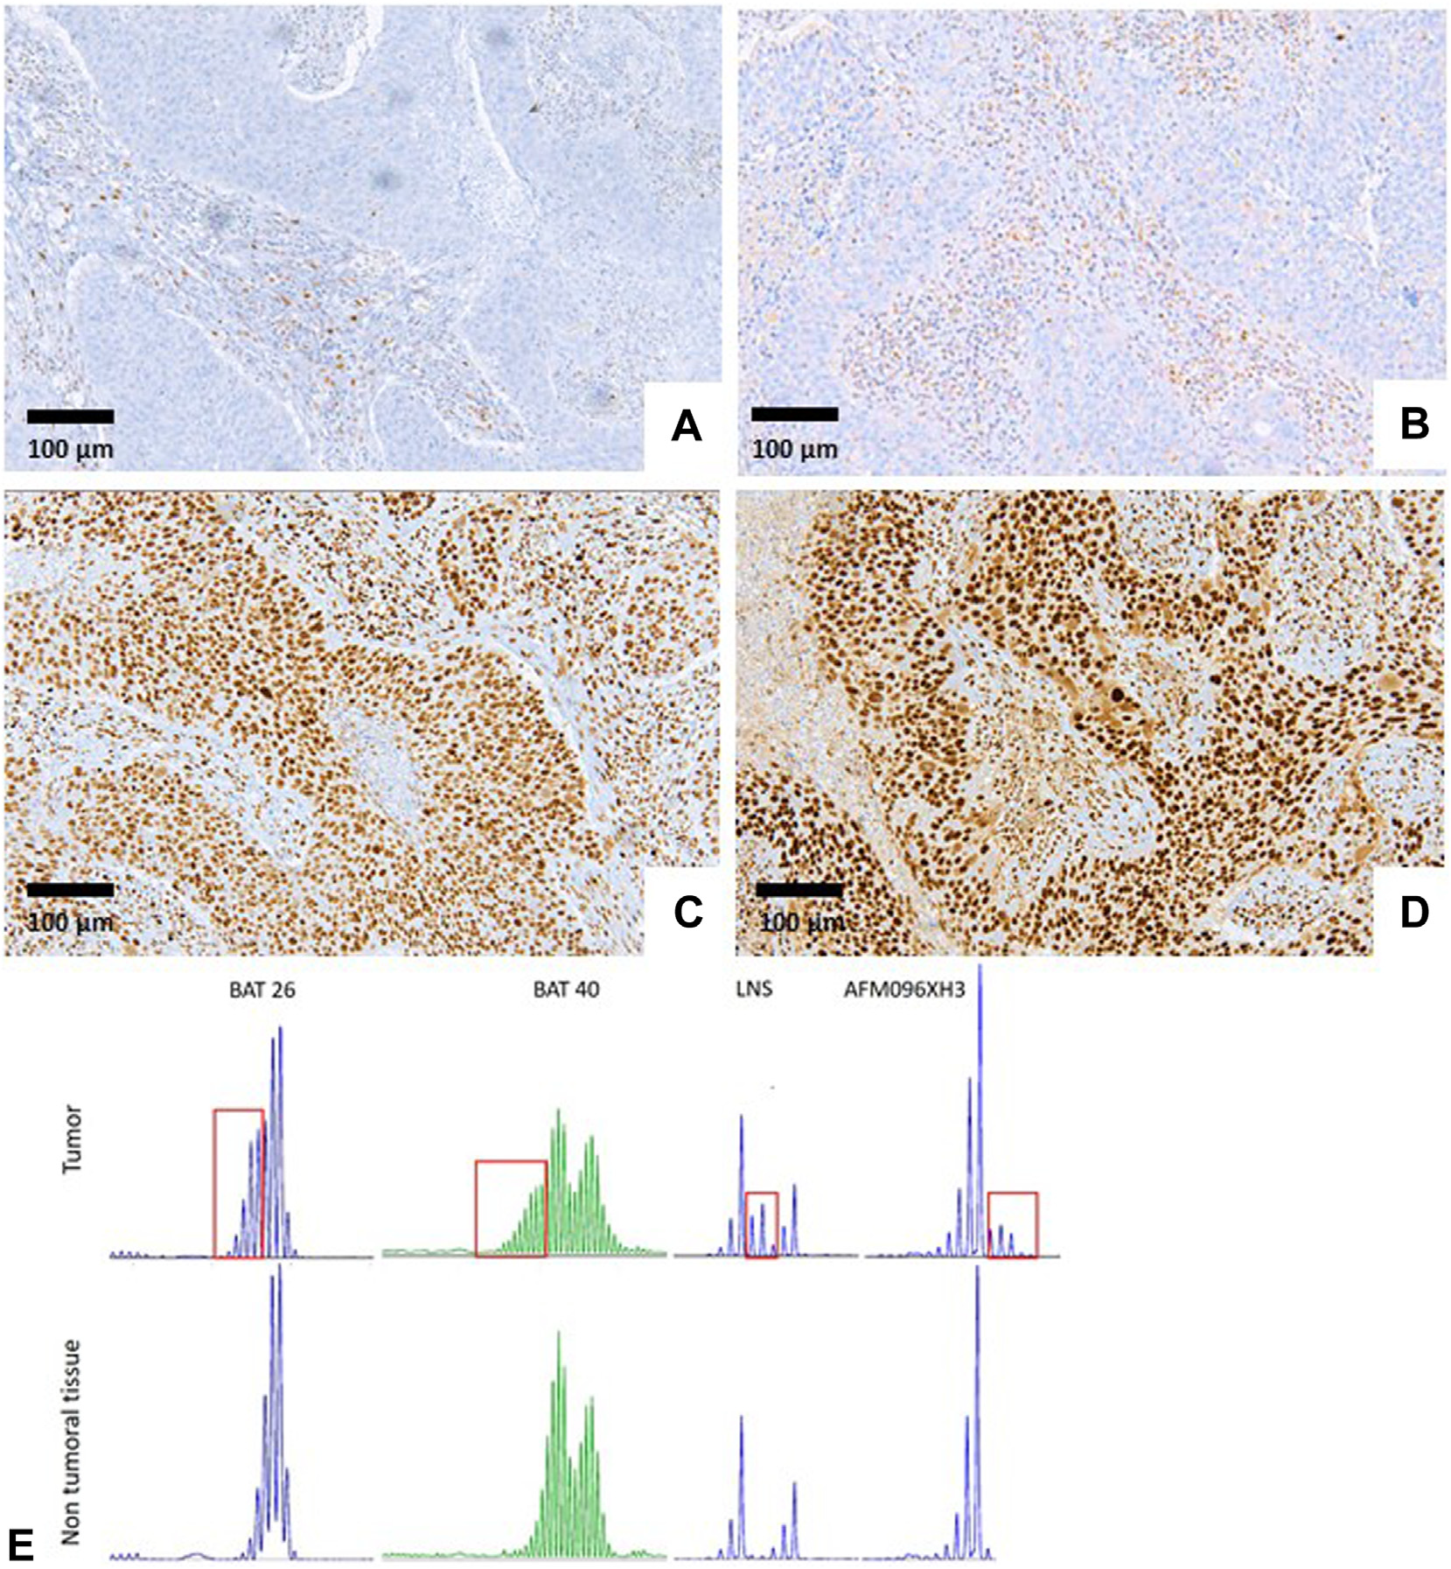
Loss of MLH1 and PMS2 expression in tumor
cells, with a remaining expression of MSH2 and MSH6
MSI was confirmed by polymerase chain reaction, with 11 tested microsatellite markers, revealing four with clear instability
In summary, the patient with Lynch syndrome was diagnosed with a dMMR invasive squamous cell carcinoma of the right upper lobe of the lung
JTO Clinical and Research Reports 2023
https://doi.org/10.1016/j.jtocrr.2023.100595

Slide 7
What is a dMMR/MSI carcinoma?
MMR proteins: How and why should they be detected in 2024?

Slide 8
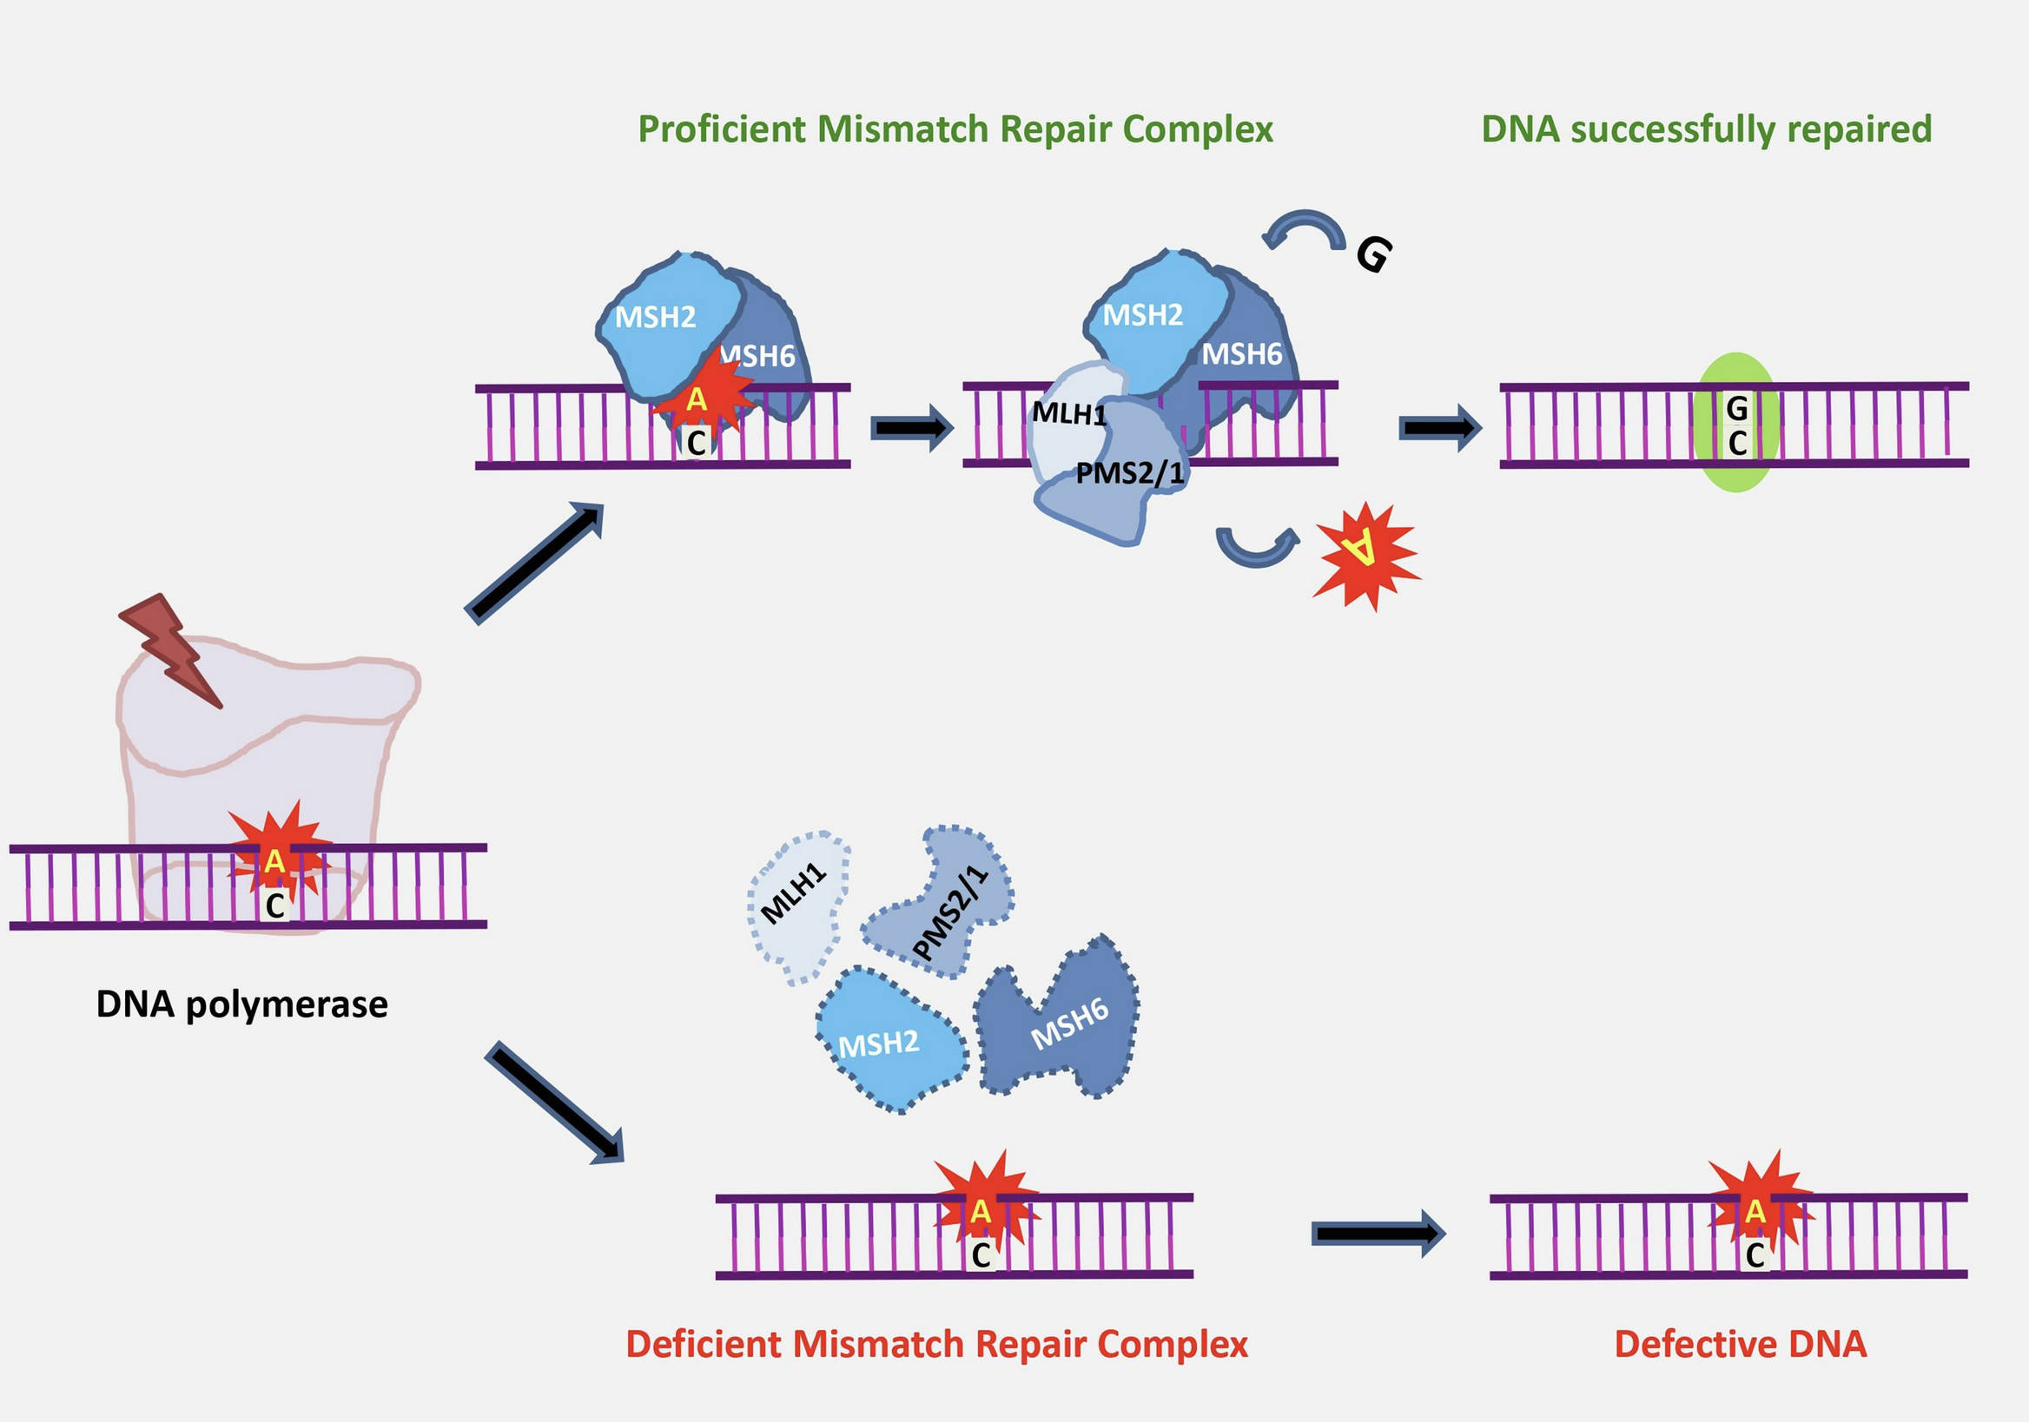
MisMatchRepair MMR system
proficient pMMR
MLH1
PMS2
MSH2
MSH6
4 repair proteins
The MMR enzymatic complex repairs the DNA errors made by the DNA polymerase
deficient dMMR
DNA polymerase make mistakes while duplicating DNA especially in repeated sequences

Slide 9
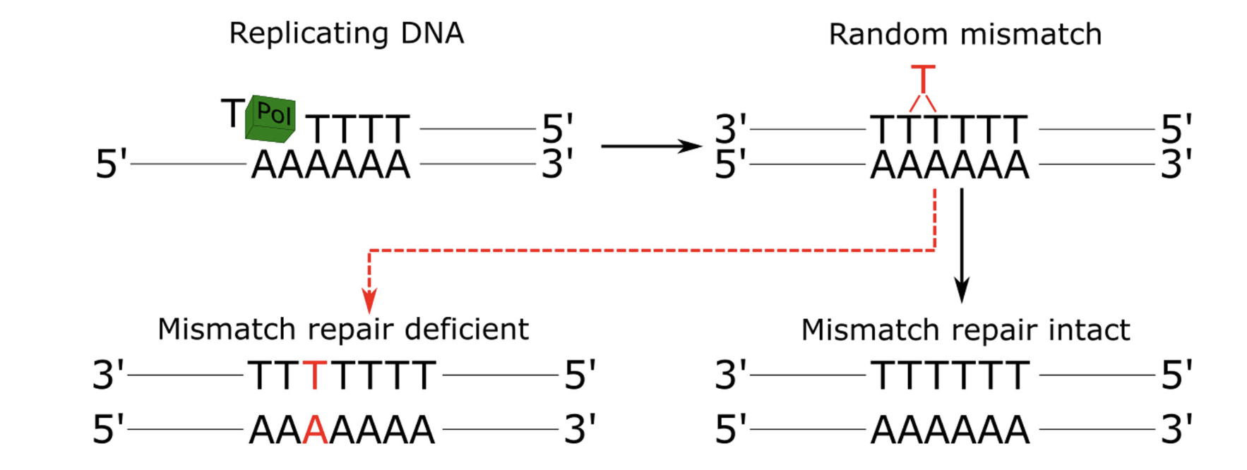
Schematic of microsatellite instability (MSI) due to deficient mismatch repair (dMMR)
Somatic inactivation of genes involved in the cell cycle, apoptosis and DNA repair:
TGF b type II receptor, IGFRII, BAX, CASP1, MSH3, MSH6...
Loss of MMR prevents a cell from repairing random mismatches between antiparallel strands that arise at repetitive regions during DNA replication, leading to propagation of random insertions/deletions (indels) in microsatellites
Cancer
Methods Mol Biol. 2020 ; 2055: 119–132. doi:10.1007/978-1-4939-9773-2_5

Slide 10
How to detect a dMMR/MSI carcinoma?
MMR proteins: How and why should they be detected in 2024?

Slide 11
1- Molecular testing
Replication ERror test (RER)
MMR proteins: How and why should they be detected in 2024?

Slide 12
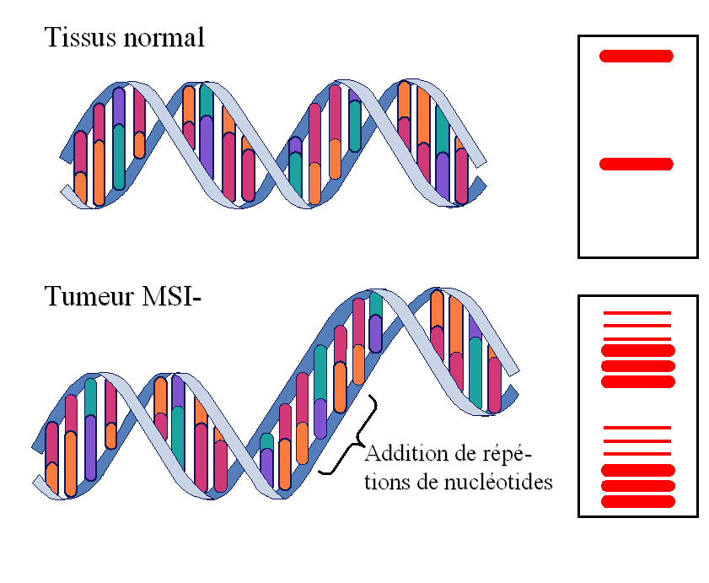
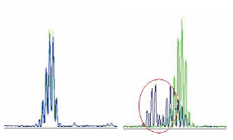
How can microsatellite instability be identified?
MSS Tumor
MicroSatellite Stable
MSI Tumor
MicroSatellite Instable
Use of 'snitches' distributed in the genome: microsatellites
Short single or dinucleotide non-coding repeats
Preferential targets of DNA replication errors
MMS tumor:
MSI tumor:
Non tumoral DNA A A A A A A
Non tumoral DNA A A A A A A
Tumoral DNA A A A A A A
Tumoral DNA. A A A A
Normal Tissue DNA
number of repetitions ≠
Tumour Tissue DNA
Addition of nucleotide repeats
Comparison of normal DNA/tumoral DNA profiles
DNA repair abnormalities

Slide 13
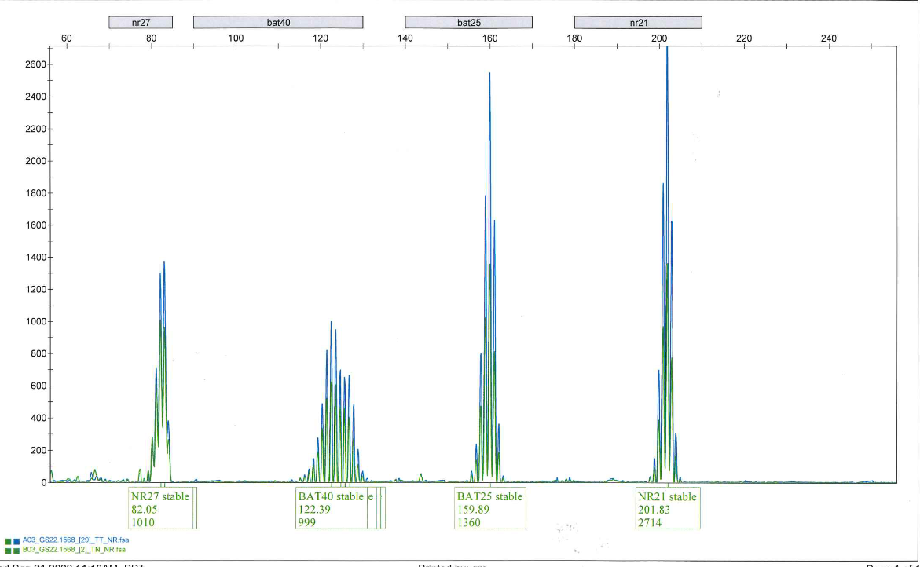
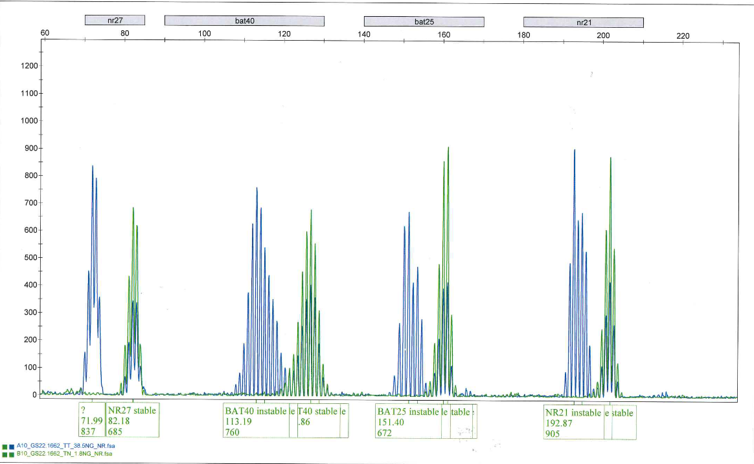
MOLECULAR TEST MSI-MSS
Unstable RER phenotype MicroSatellite Instable
MSI status
Stable RER phenotype
MicroSatellite Stable
MSS status
1998 consensus conference:
Panel of 5 microsatellite markers :
D2S123/AFM093Xh3 , D5S346/LNS , D17S250/MFd , BAT25 and BAT 26
NCI panel proposed in 2004 (PENTAPLEX PCR):
5 of the following 7 single-nucleotide markers: BAT25, BAT26, BAT40, NR21, NR22, NR24 and NR27
Panel carried out in Rouen University Hospital:
7 monomorphic microsatellite markers (BAT25, BAT26, BAT40, NR21, NR22, NR24 and NR27) combined with a panel of 4 polymorphic microsatellite markers (D2S123/AFM093xh3, D5S346/LNS, D17S250/MFd and TGFβ RII)
green curve: normal tissue
blue curve: tumour tissue

Slide 14
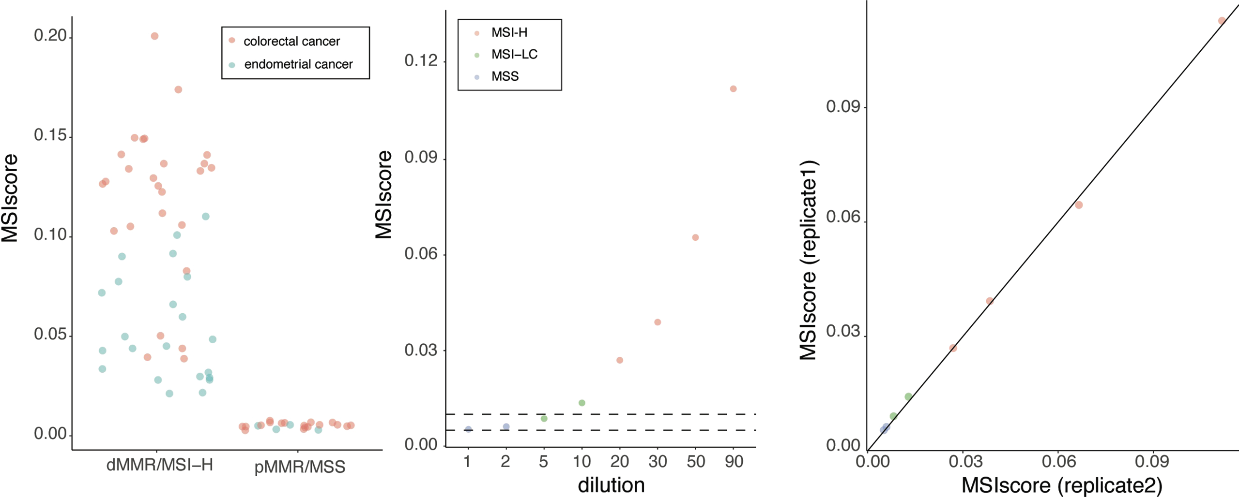
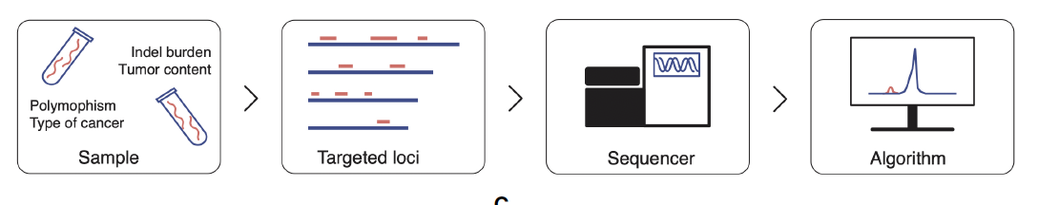
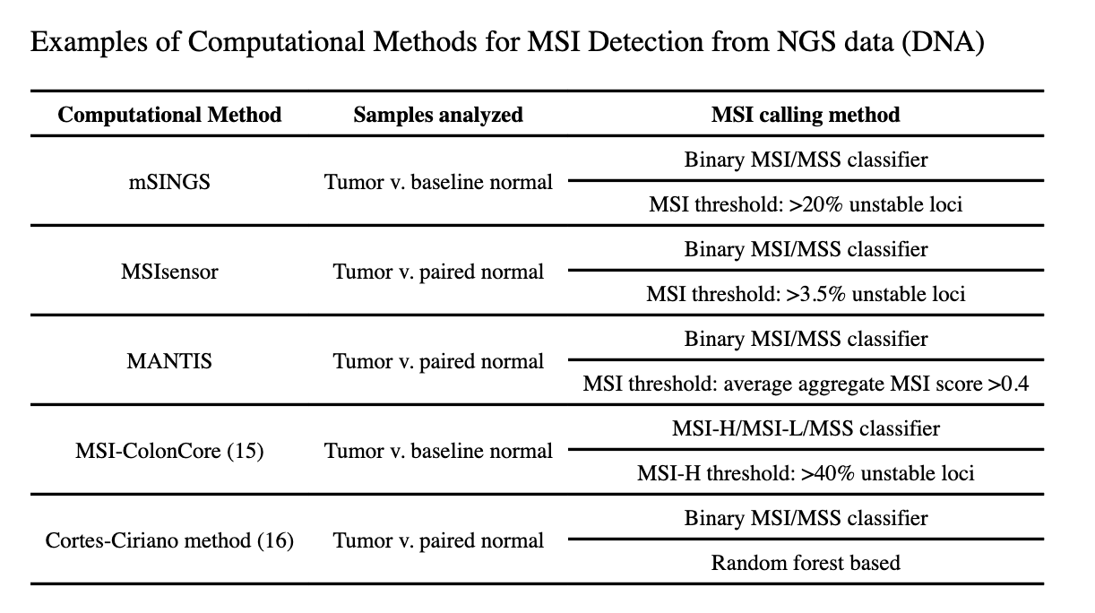
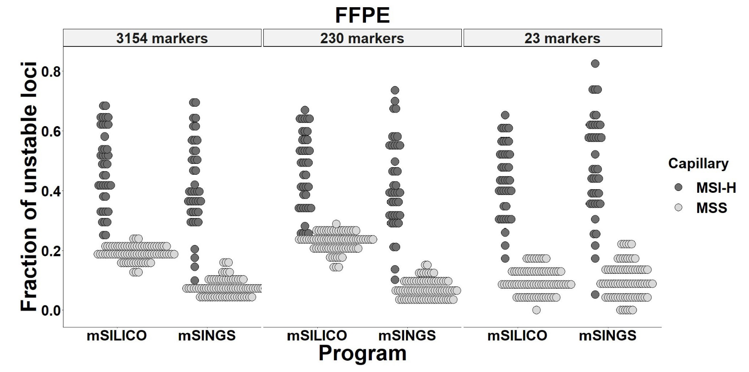
MSI status can be analysed using NGS
MSIdetect displays 100% specificity and 96.3% sensitivity
Marques AC, et al (2022) Improved NGS-based detection of microsatellite instability using tumor-only data.
Front. Oncol. 12:969238.
doi: 10.3389/fonc.2022.969238
Methods Mol Biol. 2020 ; 2055: 119–132. doi:10.1007/978-1-4939-9773-2_5

Slide 15
2- Immunohistochemistry
MMR testing
MMR proteins: How and why should they be detected in 2024?

Slide 16
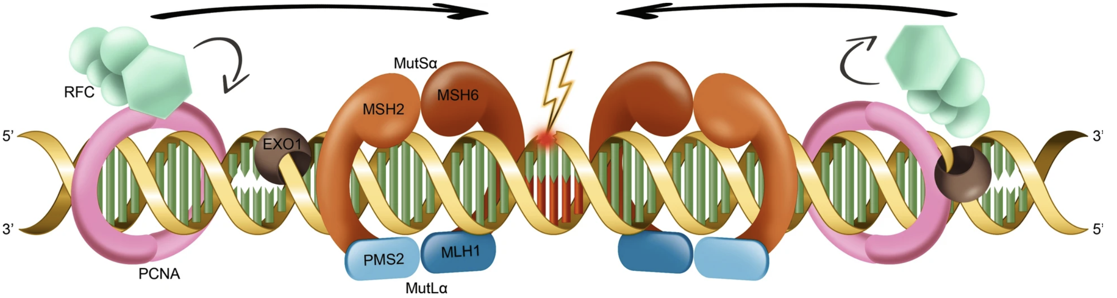
Detect the 4 MMR proteins by immunohistochemistry
Study of tissue expression of DNA mismatch repair proteins from a histological section
Advantages :
  Standard immuno technique
  Morphological control
Disadvantages :
  IHC sensitive to fixation (artefact)
  Need standardisation
Antibodies used in Rouen University Hospital:
    MLH1 : ROCHE VENTANA, clone : M1, prediluted
    MSH2 : ROCHE VENTANA, clone : G219-1129, prediluted
    MSH6 : ROCHE VENTANA, clone : SP93, prediluted
    PMS2 : AGILENT, clone : EP51, dilution : 1/40th

Slide 17
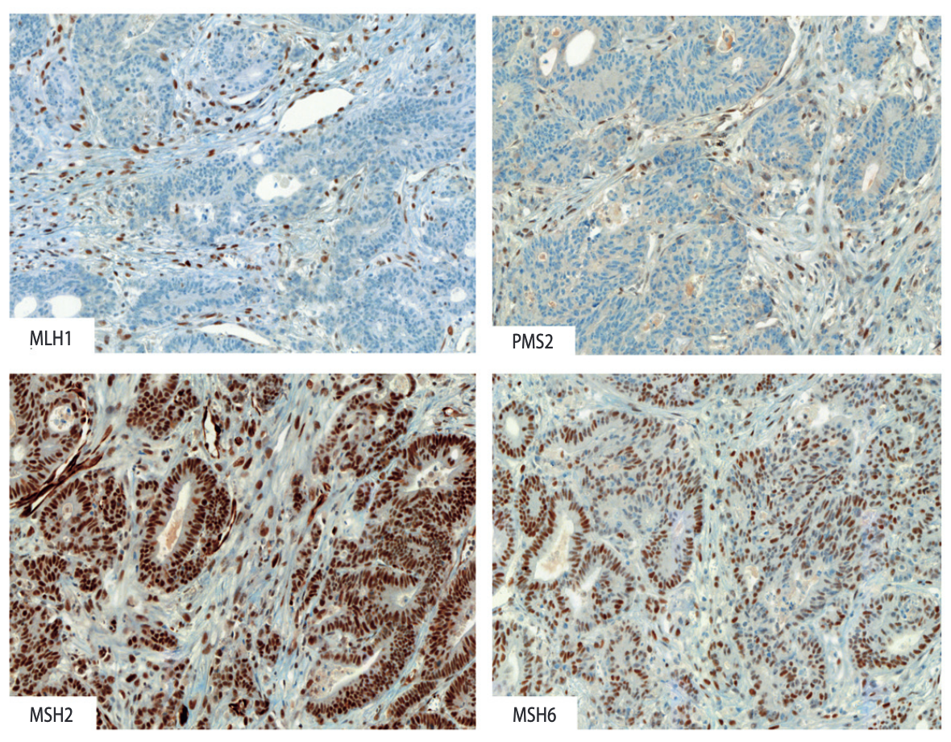
4 MMR proteins
- proficient (p)MMR
or
- deficient (d)MMR
Nuclear staining
Internal control +++
Tandem loss
when MSH2 is lost, there is tandem loss of MSH6
On the other hand, there may be isolated loss of MSH6
when MLH1 is lost, there is tandem loss of PMS2
On the other hand, there may be isolated loss of PMS2
F. Marguet et al. Correspondances en Onco-Théranostic - Vol. II - n° 1 - janvier-février-mars 2013

Slide 18
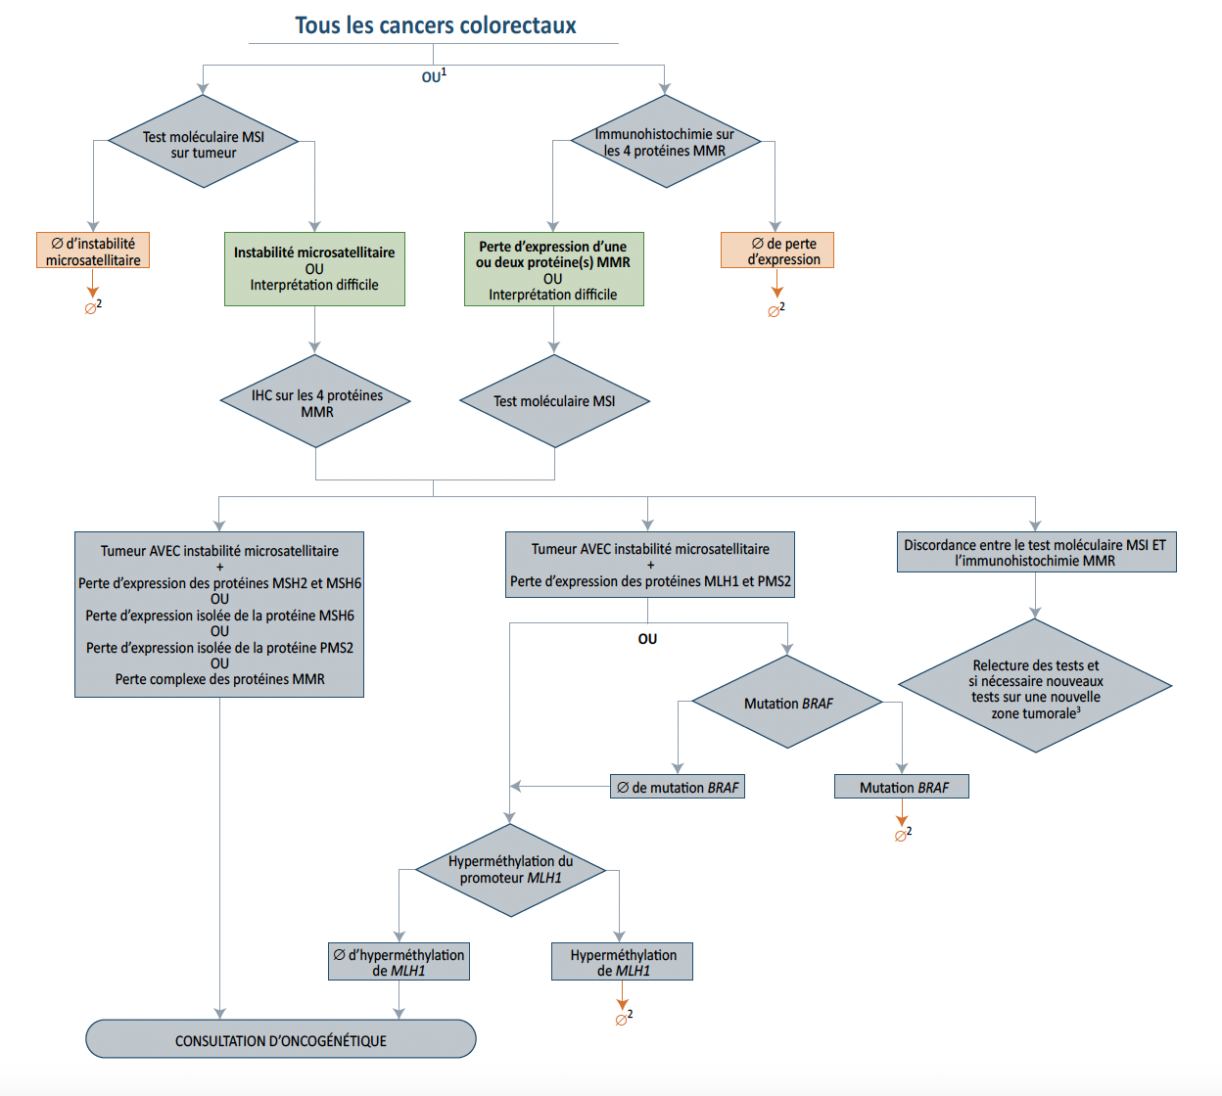
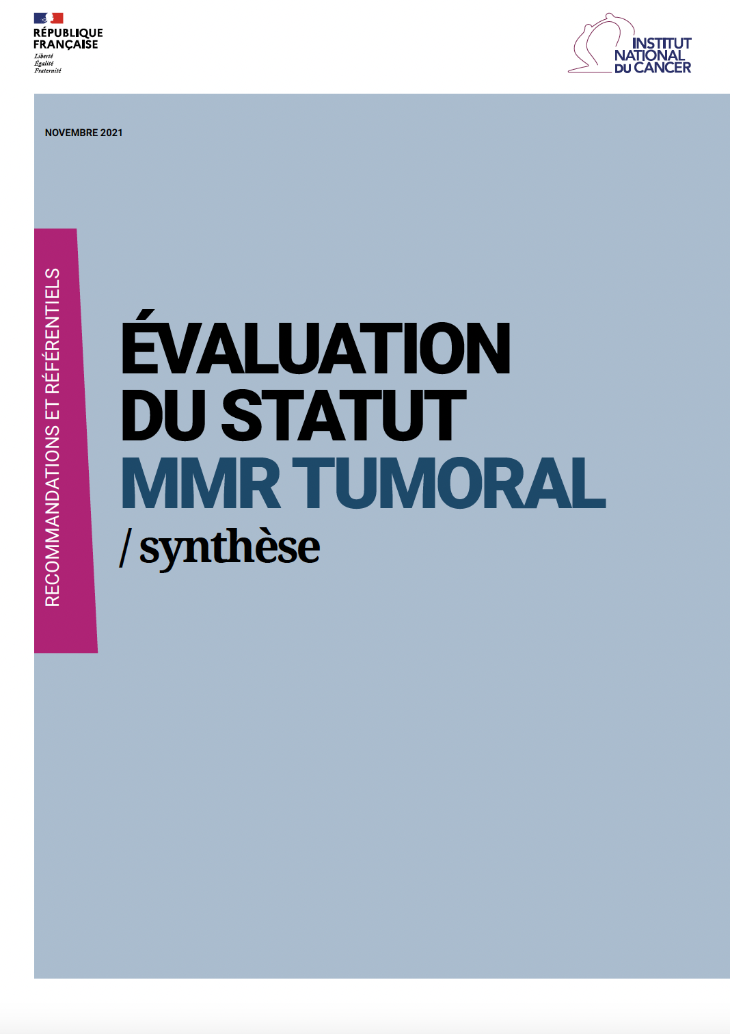

French Cancer Institute recommendations for dMMR/MSI testing
First, perform an IHC (4 Ab)
If loss of one (or 2) MMR protein(s), then confirm by RER test
https://www.e-cancer.fr/Expertises-et-publications/Catalogue-des-publications/Evaluation-du-statut-MMR-tumoral-synthese-2021

Slide 19
MMR/MSI tumor
Hereditary or Somatic alteration?
MMR proteins: How and why should they be detected in 2024?

Slide 20
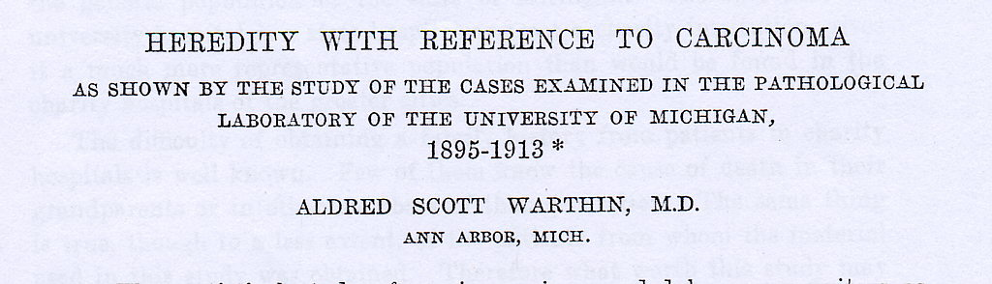
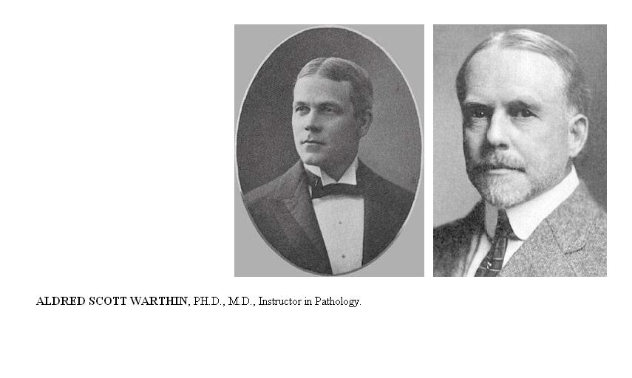
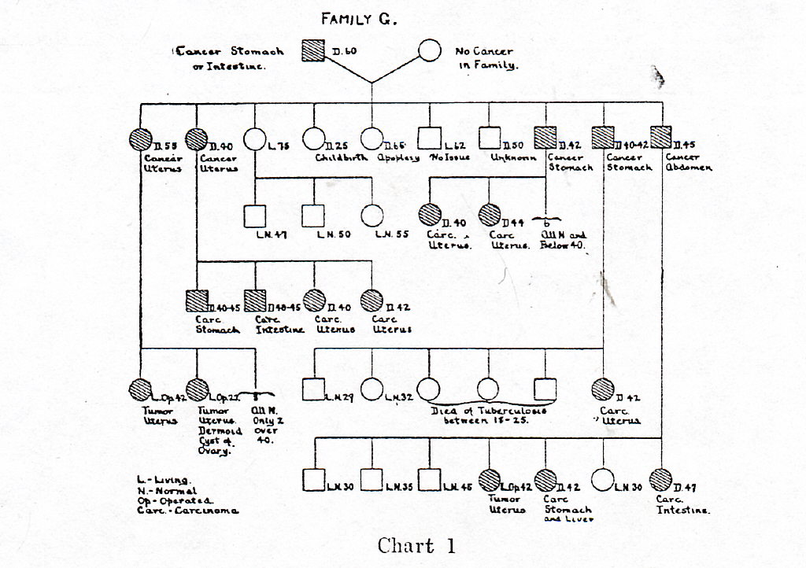

Aldred Scott Warthin
The Archives Internal Medicine 1913; 547-555
Aldred Scott Warthin
October 21, 1866 − May 23, 1931
Dr A. S. Warthin is an American pathologist whose research laid the foundation for understanding the heritability of some cancers. He has been described as "the father of cancer genetics
1st family described with hereditary cancers

Slide 21
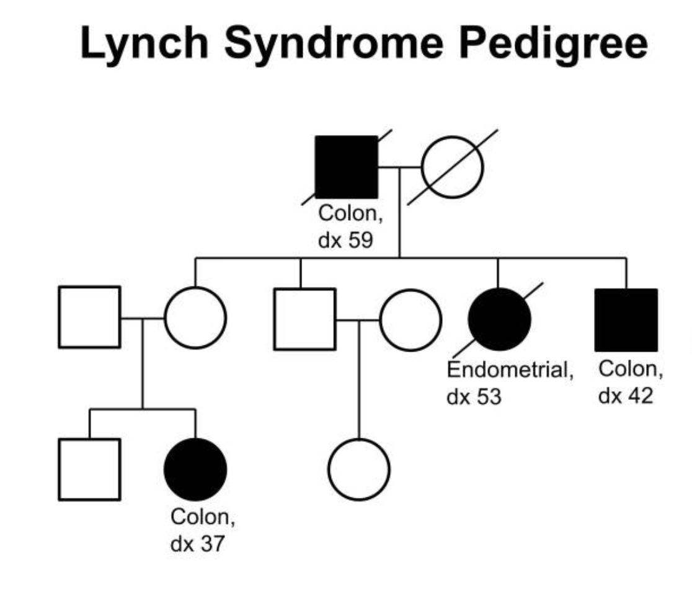

Lynch* syndrome
Constitutional mutation leading to inactivation of one of the 4 MMR gene¹: MSH2/MLH1/PMS2/MSH6
Patients with Lynch Syndrome are at a high risk of developing colorectal, uterine, ovarian, stomach, small bowel, pancreatic, kidney, and brain cancers
However, cancers with microsatellite instability outside this spectrum, for example, lung cancer, are extremely rare
Lynch spectrum cancers in 3 first-degree relatives, over two generations, with at least one case before age 50 (Amsterdam criteria)
Henry Thompson Lynch (January 4, 1928 – June 2, 2019) was an American physician noted for his discovery of familial susceptibility to certain kinds of cancer and his research into genetic links to cancer
¹ Very rarely it can be a germinal bi allelic mutation of one of the 4 MMR gene, corresponding to CMMRD syndrome (constitutional MMR deficiency)
² It should be noted that rare cases are linked to germline deletions of the EpCAM gene, leading to epigenetic inactivation of the MSH2 gene
http://www.lynchcancers.com/index.php/tribute-to-dr.-henry-t.-lynch

Slide 22
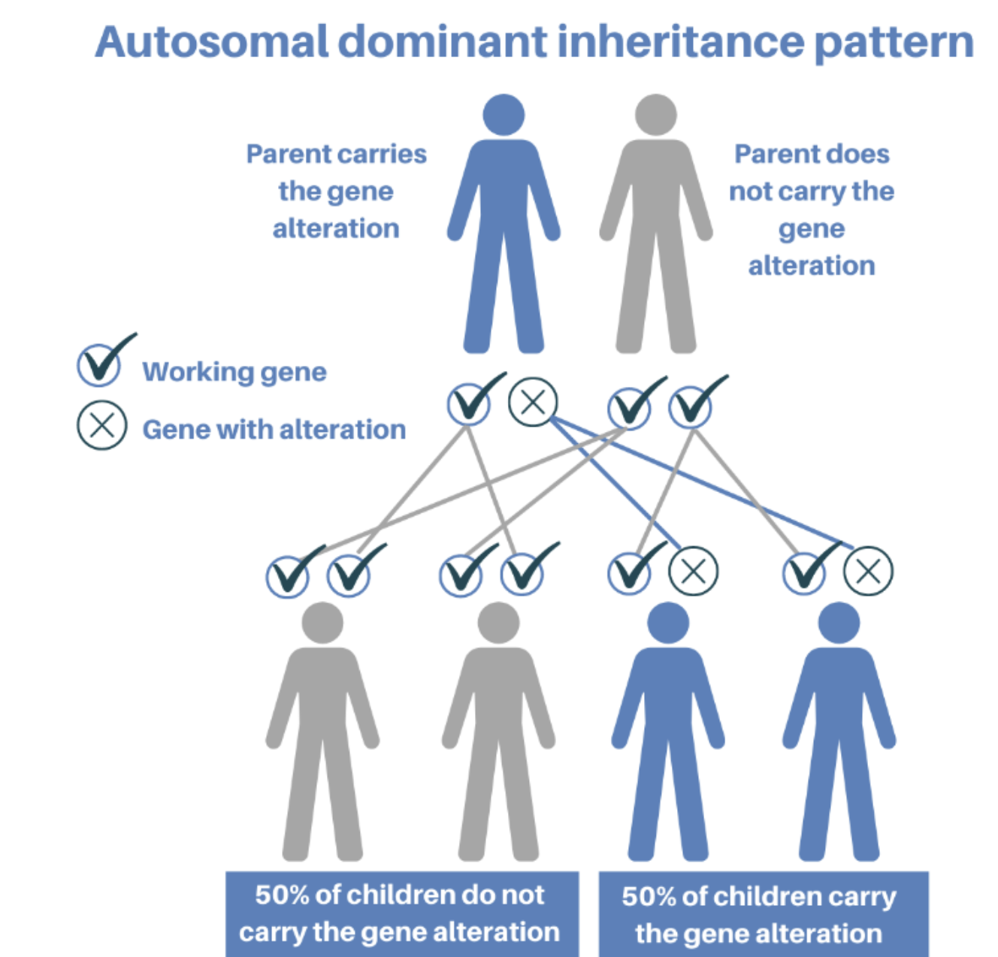
SIGNIFICANCE OF THE RER / MSI PHENOTYPE
Microsatellite Instability
MSI / dMMR
Constitutional mutation
of one MMR gene
Lynch syndrome
Somatic hypermethylation
of MLH1 promoter
Or somatic mutation of one MMR gene
The mutational frequencies of MSH2 and MSH6 in lung cancer are 1.4% and 1.6%, respectively, and 0.8% and 1.4%, respectively, in lung squamous cell carcinoma
4 cases of lung dMMR adenocarcinoma of the lung have been reported in patients with Lynch syndrome

Slide 23
Why is it important to diagnose dMMR/MSI tumor?
MMR proteins: How and why should they be detected in 2024?

Slide 24
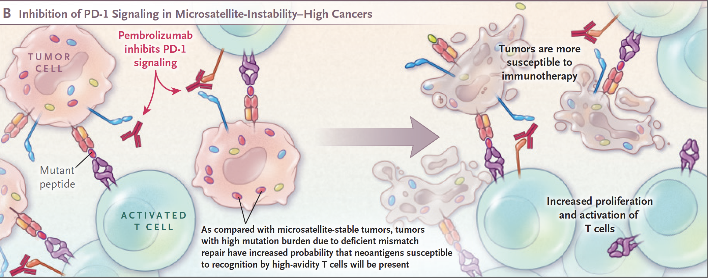
Tumors with microsatellite instability present many neoantigens
Frameshift mutations: highly immunogenic mutated proteins
dMMR/MSI tumor are sensitive to immunotherapies
NEJM 2017;377:15

Slide 25
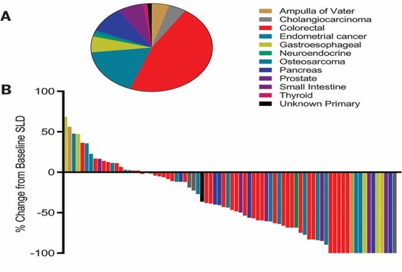
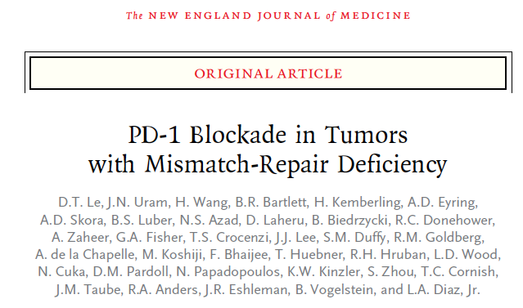

MSI carcinomas: the landmark study (Le et al. 2015-2017)
Immune Checkpoint Inhibitors for all MSI tumor
2017
LE DT N Engl J Med. 2015 Jun 25;372(26):2509-20.
LE DT Science. 2017 Jul 28;357(6349):409-413
n engl j med 377;15 nejm.org October 12, 2017

Slide 26
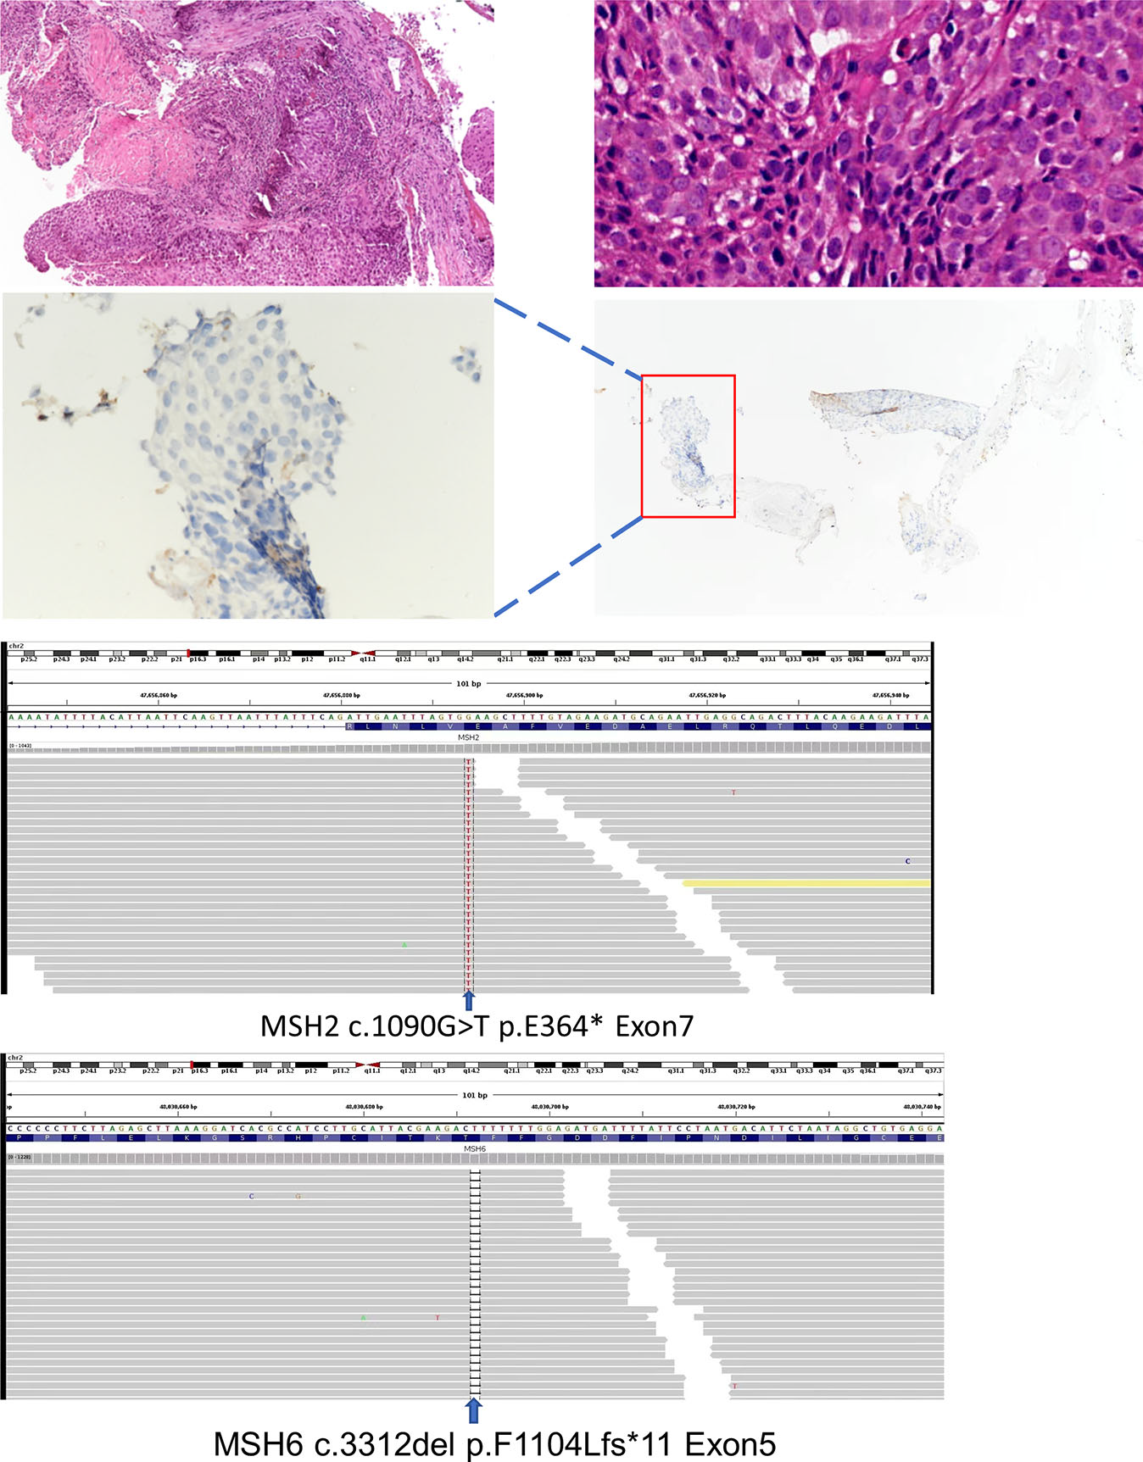
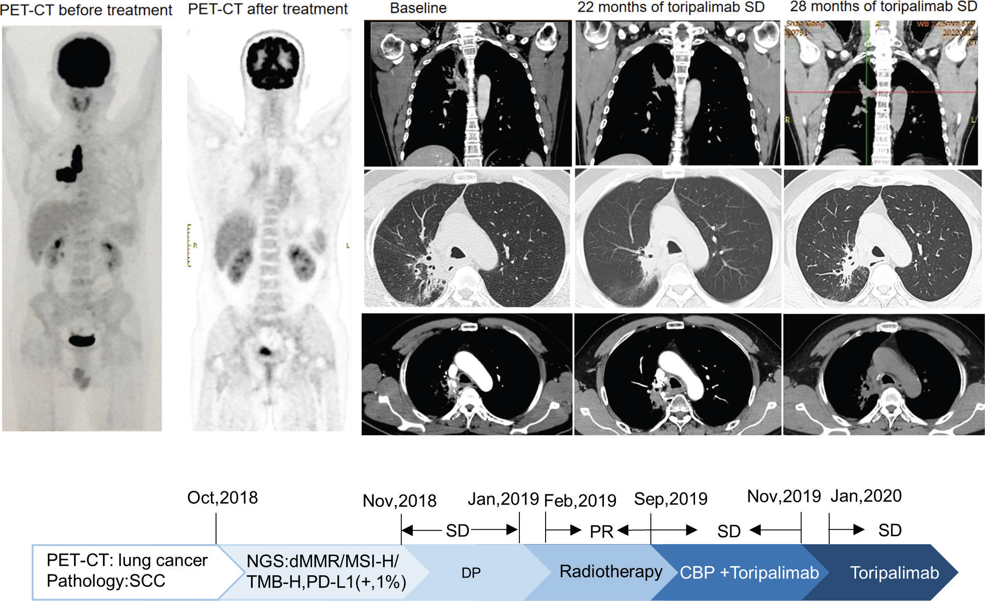
A 2nd case of NSCL dMMR squamous carcinoma
Somatic mutations in MSH2 (p.E364*Exon7), MSH6 (p.F1104Lfs*11 Exon5), TP53 (p.R213*Exon6) and PTEN (p.R130QExon5)
The patient was treated with toripalimab (anti-PD-1 Immune Checkpoint Inhibitor) with very good and durable response for 33 months
Front. Immunol. 2023
doi: 10.3389/fimmu.2022.1088683

Slide 27
And tomorrow?
MMR proteins: How and why should they be detected in 2024?

Slide 28

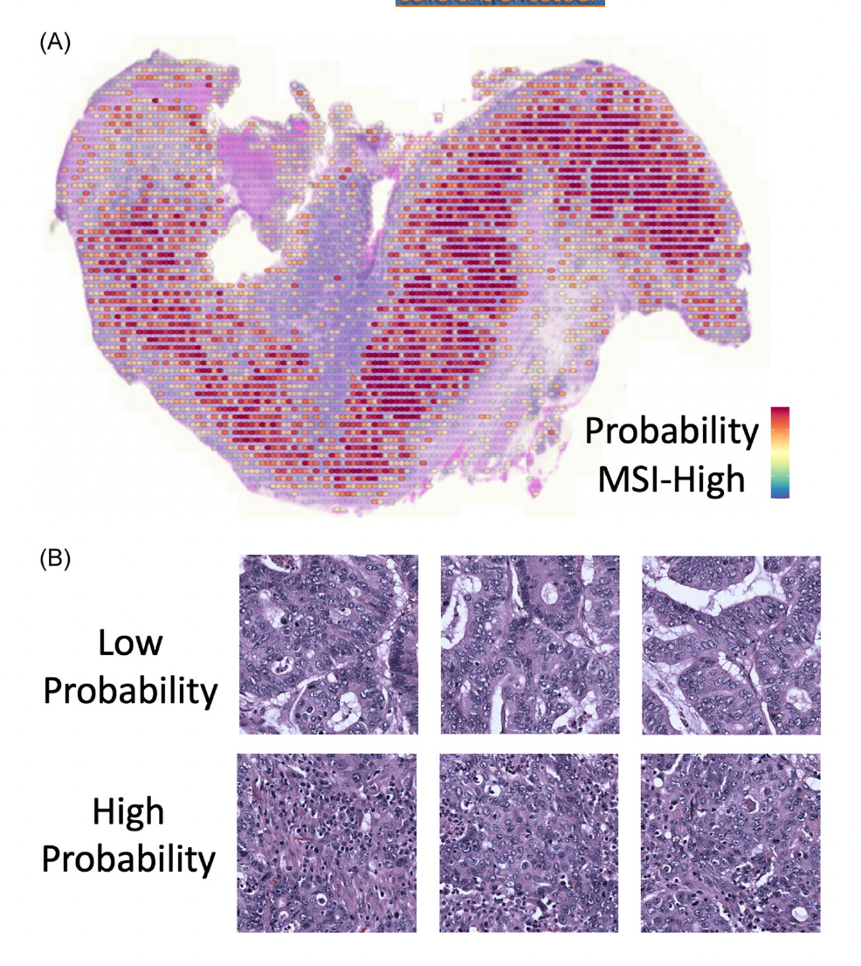
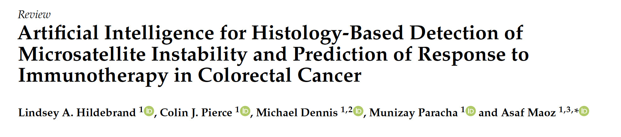
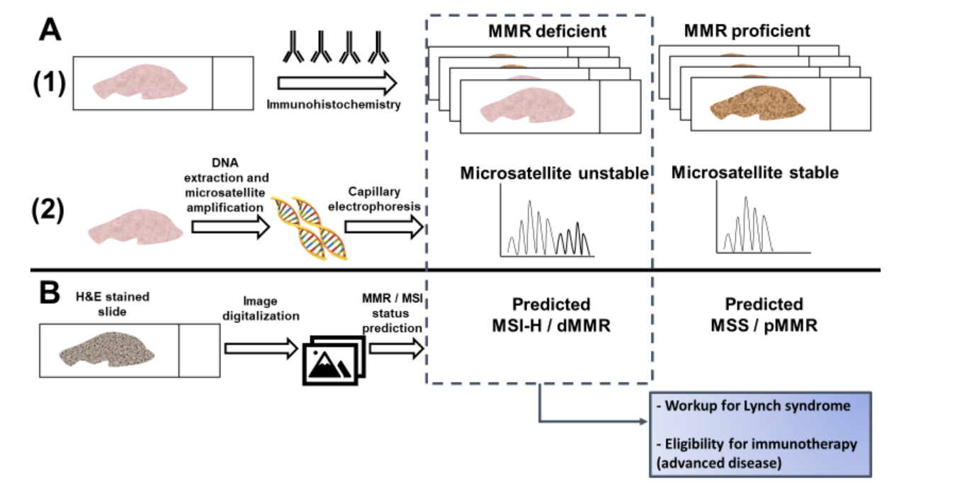
2023
J Surg Oncol. 2023;127:426–433
Machine learning can predict
MSI/dMMR with high accuracy in high quality, curated datasets
Colorectal Cancer. Cancers 2021,13,391.https://doi.org/10.3390/cancers13030391

Slide 29
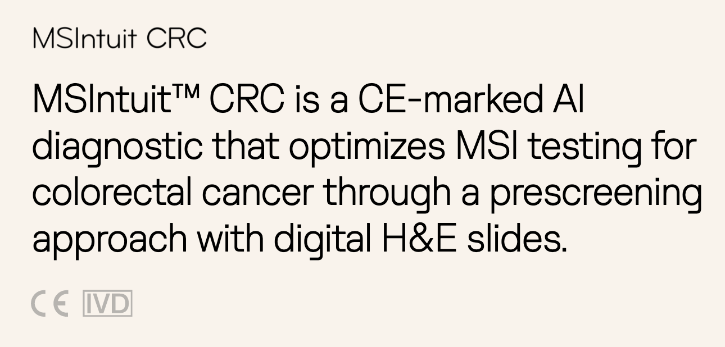
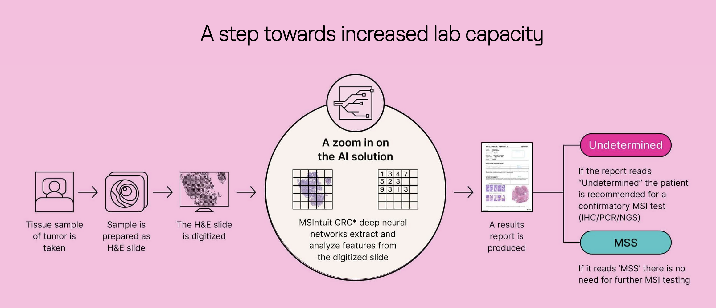


Commercially available AI algorithm to predict dMMR/MSI status (in colon tumor)
We are working with Owkin in Rouen in order to optimized this test
(1) Svrcek M, Saillard C, Dubois R, et al. Blind validation of MSIntuit, an AI-based pre-screening tool for MSI detection from colorectal cancer H&E slides. Poster presented at: European Society for Medical Oncology (ESMO); May 9th - 13th 2022; Paris France.

Slide 30
Conclusion
Primary dMMR/MSI lung (adeno or squamous) carcinoma are rare tumors
However, these rare tumors can benefit from immunotherapy +++
A dMMR/MSI status should be performed in case of family cancer history and in every carcinoma metastasis in the lung (IHC followed by RER test)
Tomorrow AI will help us to better diagnose these tumors

Slide 31
obrigado!

